Slide 1
Building a World of Peace- The Women’s Way Curriculum

Slide 3
Modules & Authors
Module 1 Empowering the Self | Module 2- Empowering the Family
Dignity as a Cornerstone for a Culture of Peace | How to be a Pool of Love | The Many Roles of a Woman | Prenatal Education | Famili-archy
Ingrid Lindemann | Aleksandra Skonieczna & Ingrid Lindemann | Gabriele Zohrer | Ioanna Mari | Carolyn Handschin
Module 3- Empowering the Society
Impact of Leadership | Impact of Values for a peaceful society | Conflict resolution | Ecology
Carolyn Handschin

Slide 4
Module 1- Empowering the Self
Dignity as a Cornerstone for a Culture of Peace by Ingrid Lindeman

Slide 5
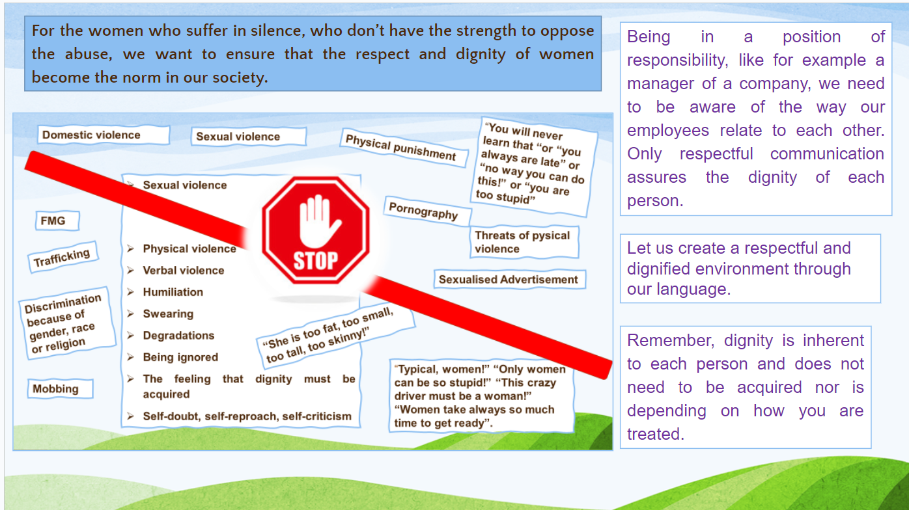
Dignity as a Cornerstone for a Culture of Peace
Monsters of Degradation
About identifying the different types of violence and degradations that one can experience throughout one’s life. And that it is important to talk about these monsters that hurt our dignity so that we can actively stop them and heal.

Slide 6
Module 1- Milestones on the way to strengthen our Dignity-self

Slide 7
Module 1- Milestones on the way to strengthen our Dignity-self

Slide 8
Module 1- Dignity as a mandate
Dignity as a way of life

Slide 9
Module 1- Human Dignity- Dignity of Men and Women

Slide 10
Module 2- How to be a pool of love
The art of loving and empathetic communication
Positive love, negative love & true love.
Love respectfully
Love as an action, not just rhetoric
“Mastering the art of love is a life-time job.”

Slide 11
Module 2- The many roles of a woman
Child, sibling, spouse, parent and more
Normally love and character-building are learnt in the home.
A mother’s well-being has big impact on a child
Leaders trained by motherhood has empathy when resolving conflict and is better placed to understand.

Slide 12
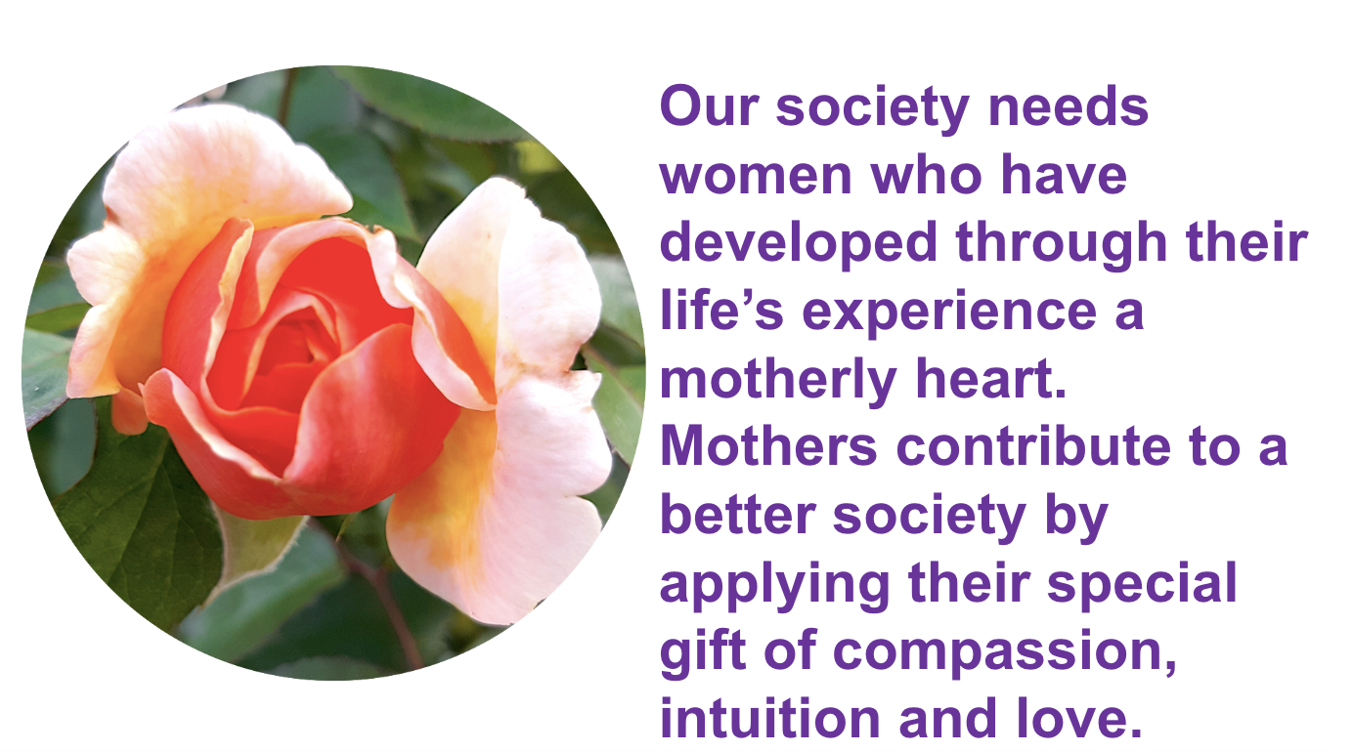

Slide 13
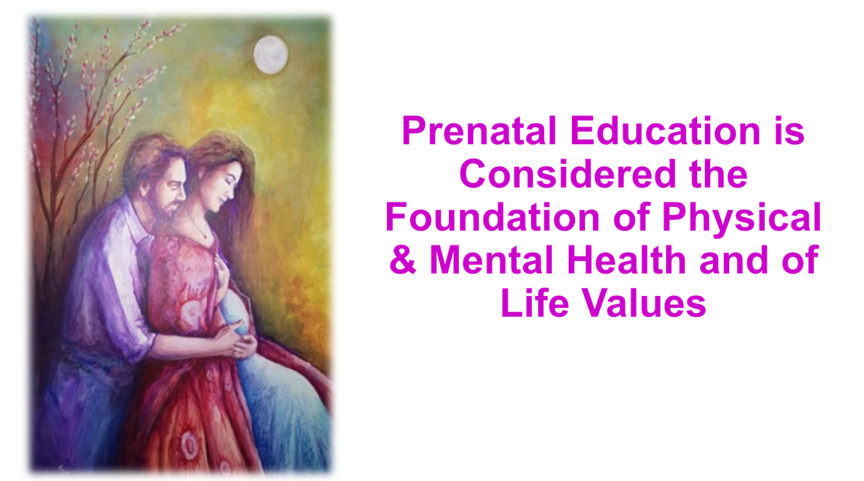
Module 2- Prenatal Education
How to be a Pool of Love

Slide 14
10 Golden Rules for future Parents
Conception with love
Eat healthy and take in proper nutrition
Take deep breaths
Calm your soul by walking in nature
Touch your child with love
Wish that your child may be gifted with virtues
Sing, play and listen to melodic music
Look at your child as the bright sun
Be watchful of your peers
Welcome the birth of the child who came to your family and breastfeed it with Love.

Slide 16
10 Golden Rules for future Parents
Conception with love
Eat healthy and take in proper nutrition
Take deep breaths
Calm your soul by walking in nature
Touch your child with love
Wish that your child may be gifted with virtues
Sing, play and listen to melodic music
Look at your child as the bright sun
Be watchful of your peers
Welcome the birth of the child who came to your family and breastfeed it with Love.

Slide 17
Module 2- Famili-archy
Famili-archy |ˈfam(ə)lē ˌärkē|
“A form of social organization in which the family unit is the nexus; seeking collaboration, rooted in love and shared responsibility, over dominance.”

Slide 18
Module 2- Famili-archy
Patriarchy, matriarchy, famili-archy
Universal Family rights
The evolution of the concept of rights
Sustainable Peace Culture

Slide 20
Module 3- Impact of Leadership
Universal leadership virtues: What virtues do I need as a leader?
The real power of community (interactive exercises)
A global history of women’s rights

Slide 21
Module 3- Impact of Leadership

Slide 22
Module 3- Impact of values for a Peaceful Society
Living for the Sake of others
Development of the Heart
How do we change culture?
Activism

Slide 24
Module 3- Conflict Resolution
Peace building and conflict resolution
Connecting with & fulfilling the SDGs
Process of reconciliation
Women & Peacemaking
Sustainable peace

Slide 26
Module 3- Ecology
Ecologically responsible stewardship and care for nature.
How can I impact the world?
Group project
Youth empowerment

Slide 28
Thank you!

